Slide 1

Capstone Project
Movie Rental Analysis
Presented By:- Monisha Goswami

Slide 2

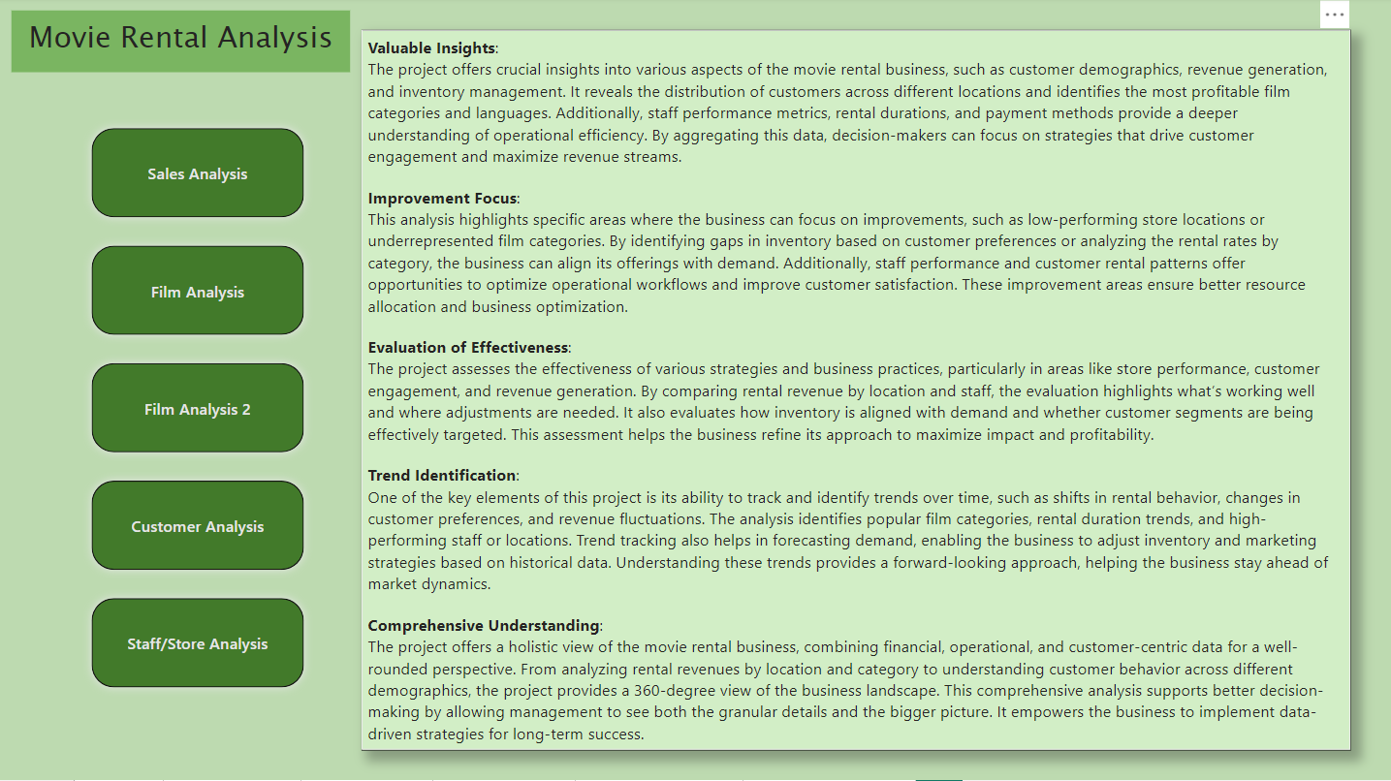

Slide 3
Project Objective:
The primary objective of this analysis is to unlock key business insights from the movie rental data, enhancing operational efficiency, customer satisfaction, and revenue growth. We aim to identify high-performing customer segments, optimize inventory, and understand the trends driving rental behavior.
Analysis Scope:
Sales Trends: A monthly breakdown to observe fluctuations in revenue.
Customer Behavior: Analysis of purchasing patterns, identifying new vs. repeat customers.
Inventory & Rentals: Insights into film categories, rental durations, and inventory management.
Store Performance: Performance evaluation across different locations, both operationally and financially.
Geographical Insights: Customer distribution by city and country to optimize regional strategies.

Slide 4
Goal:
To provide actionable insights that help decision-makers optimize film inventory, target key customer segments, and improve store performance for increased profitability.
Insights & Recommendations:
Loyal Customers: Focus on retention strategies to maximize revenue from repeat customers.
Popular Genres: Prioritize marketing of high-demand genres like Action and Drama.
Location Strategy: Urban stores outperform—expand in high-density areas.
Seasonal Peaks: Increase inventory during high-demand periods for maximum profit.
Report and Presentation:
This presentation offers data-driven insights via Power BI and SQL analysis, helping stakeholders make informed decisions on customer behavior, sales performance, and inventory management for future growth.

Slide 5
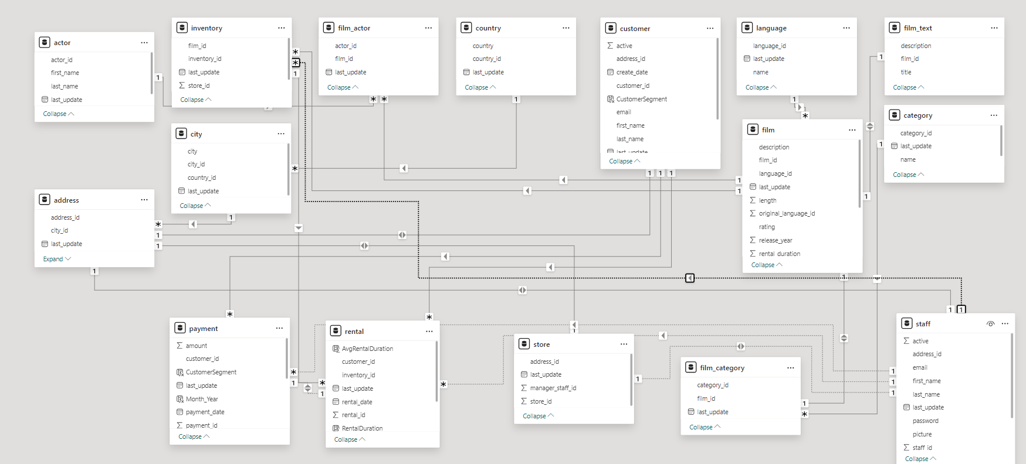
ER Diagram_Movie_Rental_Analysis

Slide 6
Power BI Problem Statement

Slide 7
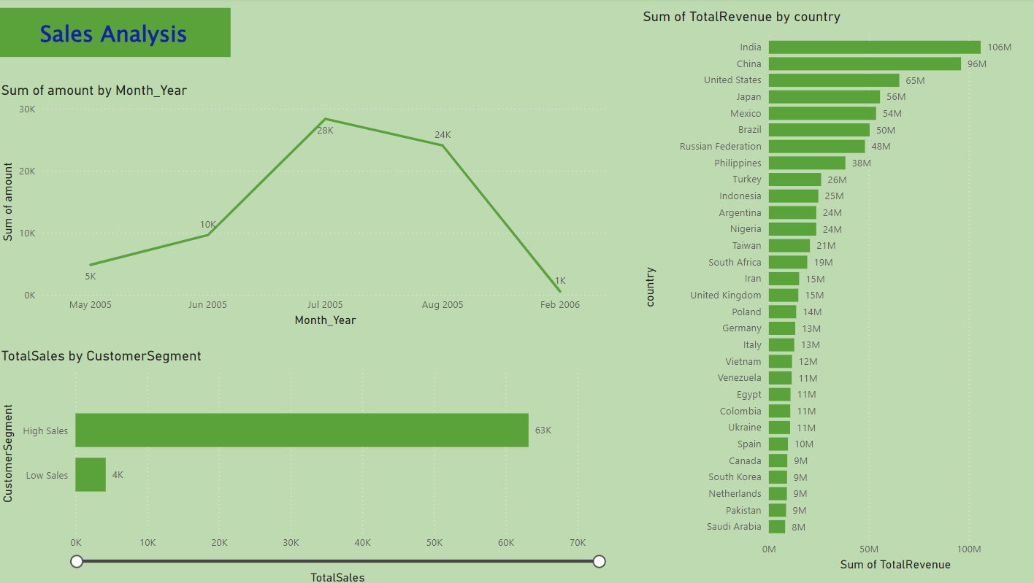

Slide 8
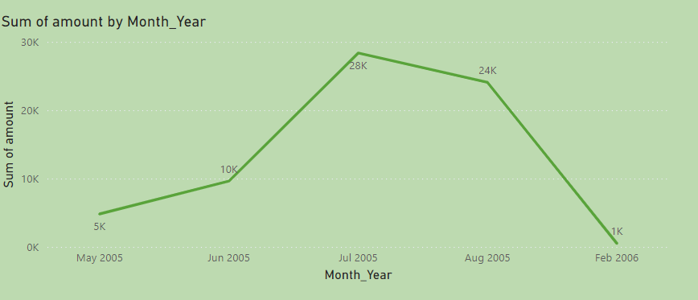
How does the sales revenue vary by month?
Sales revenue peaks sharply in July 2005,
suggesting a seasonal high possibly driven
by special releases or promotions.
The significant decline post-July indicates a
drop in customer engagement, emphasizing
the need for targeted marketing and inventory
strategies during off-peak months to
sustain revenue.

Slide 9
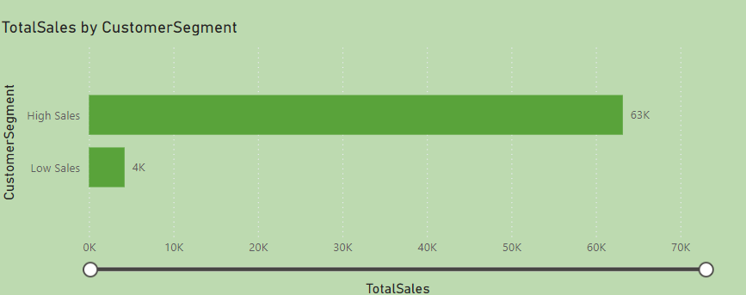
Which customer segments generate the highest sales?
The "High Sales" customer segment contributes
significantly to total sales, accounting for 63K,
compared to the "Low Sales" segment which
only contributes 4K. This stark contrast highlights
the importance of focusing marketing and retention
efforts on the "High Sales" segment to maximize
revenue potential.

Slide 10

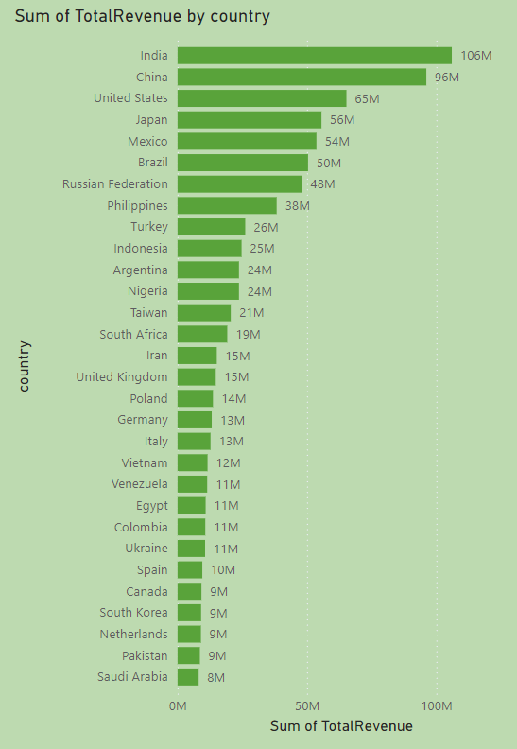
How does the rental revenue vary by country?
India leads with the highest rental revenue at 106M, followed by China and the United States with 96M and 65M respectively, indicating strong market presence in these regions. Countries like Saudi Arabia, Pakistan, and South Korea show significantly lower revenues, suggesting potential growth areas or markets requiring different strategic approaches to enhance performance.

Slide 11
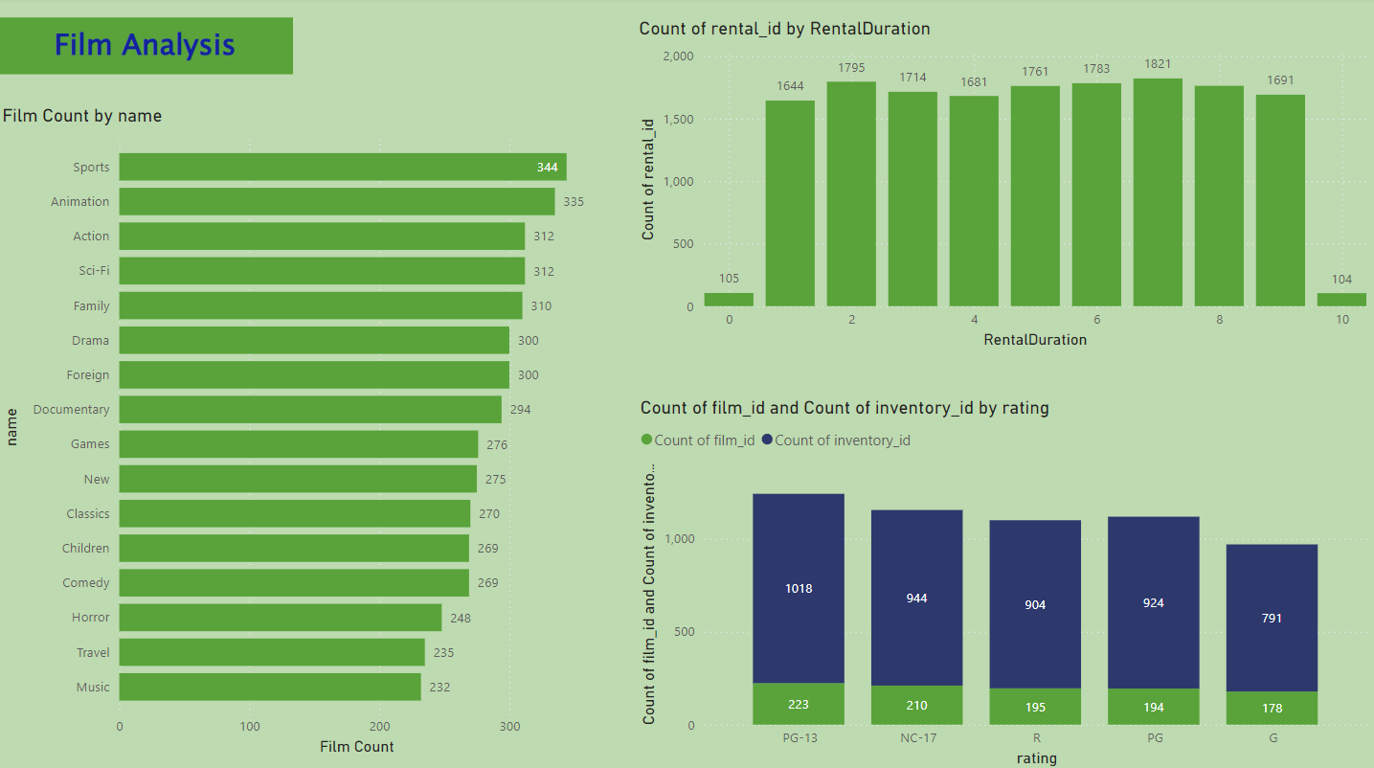

Slide 12
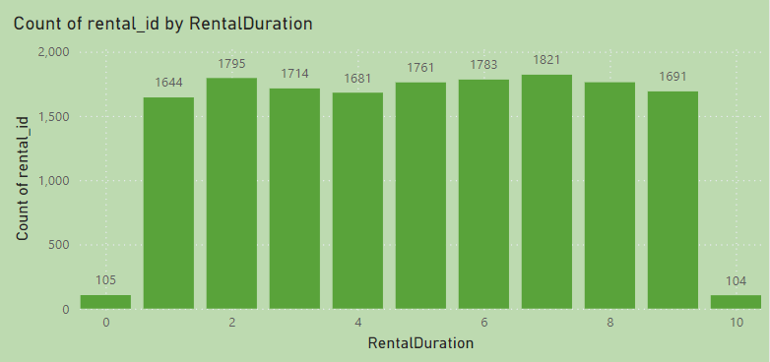
What is the distribution of films by rental duration?
The distribution of film rentals shows that durations of 2 to 10 days are almost uniformly popular, each accounting for around 1,600 to 1,800 rentals. However, extremely short (0 days) and long (10 days) rentals are significantly less common. This uniformity in the middle range suggests a consistent customer preference for standard rental periods, while the low counts for the shortest and longest durations indicate niche preferences. This information could be used to optimize inventory and pricing strategies based on rental duration preferences.

Slide 13
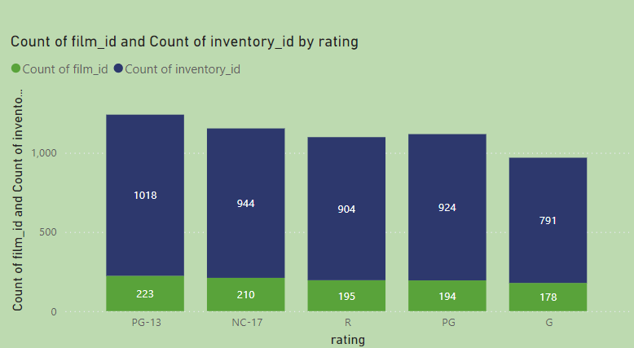
How does the inventory vary by film rating?
The inventory distribution by film rating shows PG-13 as the most stocked category, closely followed by NC-17, R, and PG ratings, indicating a focus on adult and mature audiences. G-rated films have the least inventory, suggesting less demand or prioritization. This strategy might cater well to the primary customer base but could also limit audience reach for family-oriented films. Adjusting inventory to include more G-rated films might capture a broader family market, especially during family-friendly seasons or promotions.

Slide 14
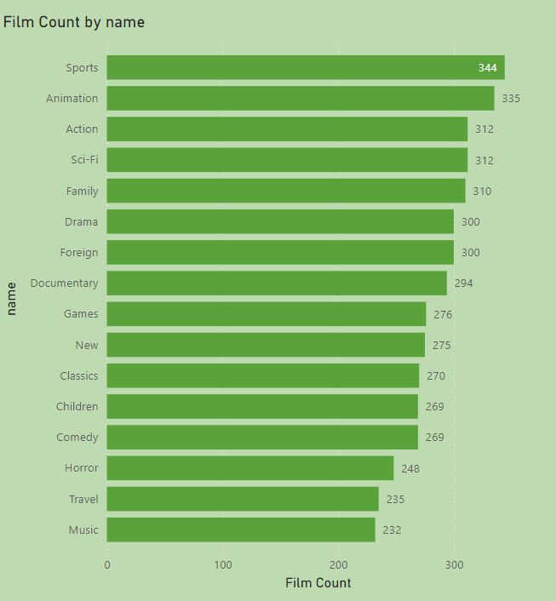
What is the breakdown of film categories
in the inventory?
The inventory shows a balanced distribution across various film categories, with Sports and Animation having the highest representation. The presence of a diverse range of genres, from Action and Sci-Fi to Family and Drama, indicates a strategy to cater to broad customer preferences. However, niche categories like Music and Travel have fewer films, suggesting potential areas for expansion to capture interest from specific audience segments looking for variety.

Slide 15
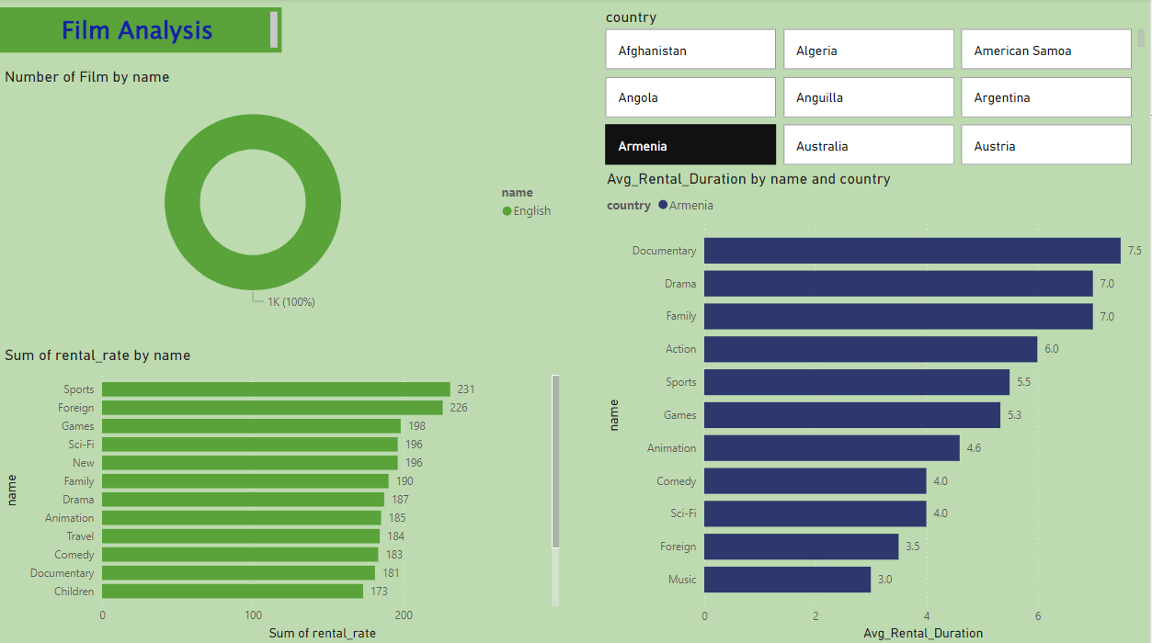

Slide 16
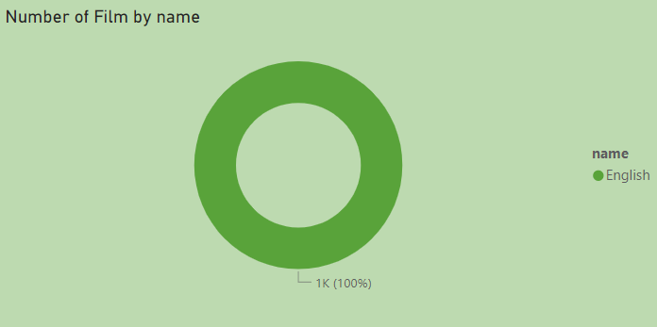
What is the distribution of films by language?
The inventory exclusively features films in English, representing 100% of the selection. This singular focus on English language films simplifies inventory but may limit the reach to non-English speaking audiences. Diversifying the language offerings could tap into new customer segments and expand market presence, particularly in multilingual regions.

Slide 17
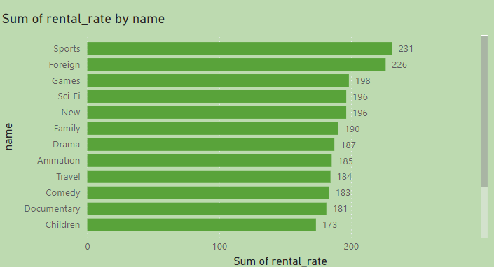
Which film categories have the highest
rental rates?
Sports and Foreign films have the highest rental rates, significantly outperforming other genres. This indicates a strong demand for these categories, suggesting they are premium offerings in the inventory. Given their popularity and profitability, marketing and promotional efforts should prioritize these genres to maximize rental revenue. Additionally, considering stocking more titles within these categories could further capitalize on their high demand.

Slide 18
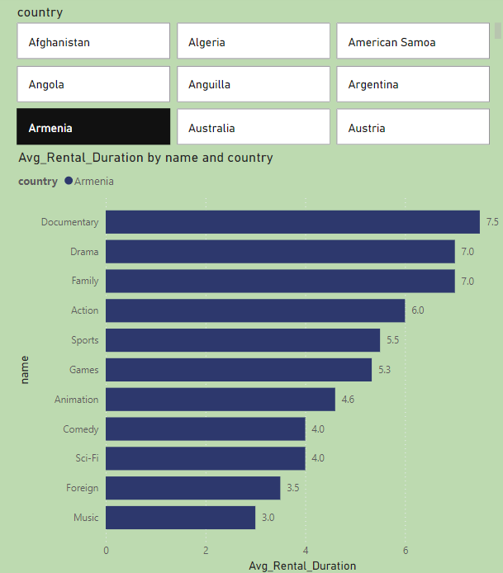
How does the average rental duration vary by
film category?
The variation in average rental durations across film categories in Armenia reflects distinct consumer preferences and viewing behaviors. Categories with longer rental durations like Documentary and Drama may benefit from targeted promotions during holidays or as part of educational packages, maximizing their appeal to audiences seeking in-depth exploration or emotional stories. Conversely, categories with shorter durations such as Comedy and Music might be better suited for promotions during weekends or as part of a bundle offering quick entertainment options. Understanding these patterns enables a strategic approach to inventory stocking and marketing, ensuring that consumer demand is met efficiently and effectively.

Slide 19
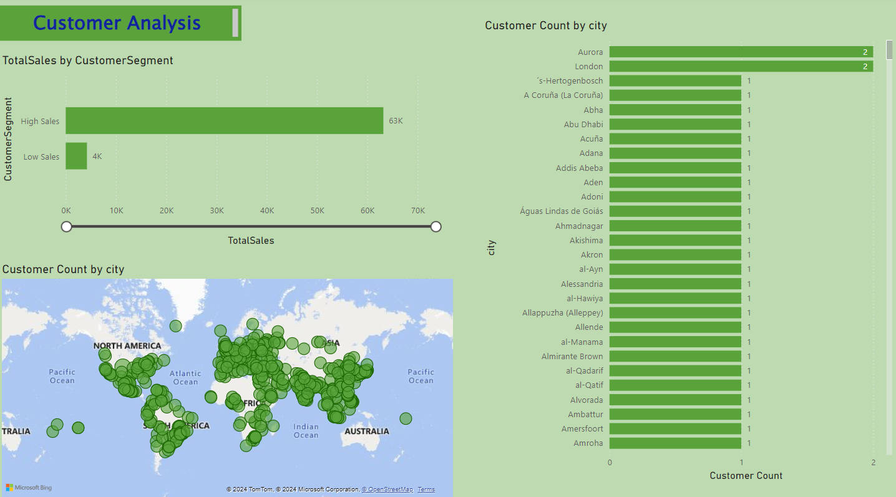

Slide 20
Which customer segments generate the highest sales?
The "High Sales" customer segment contributes
significantly to total sales, accounting for 63K,
compared to the "Low Sales" segment which
only contributes 4K. This stark contrast highlights
the importance of focusing marketing and retention
efforts on the "High Sales" segment to maximize
revenue potential.

Slide 21
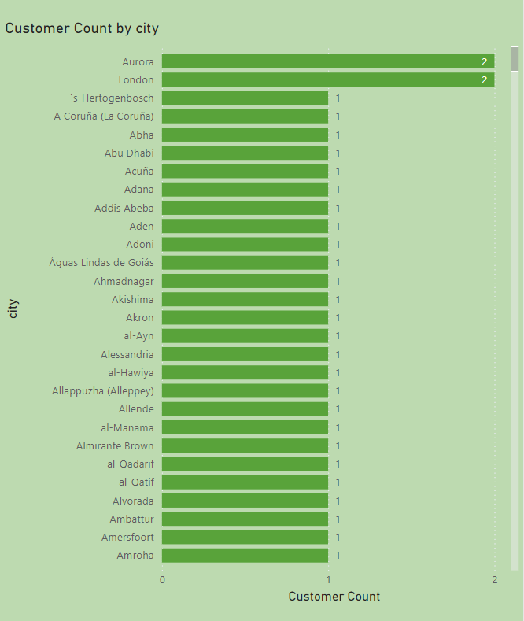
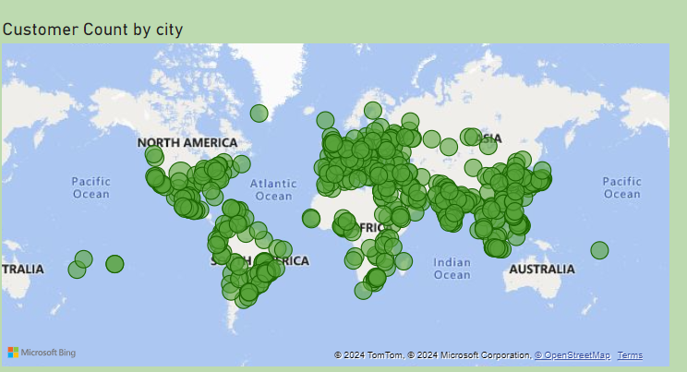
What is the distribution of customers across
different cities?
The customer distribution across cities is highly dispersed with significant concentrations in a few urban centers. The map visualization shows a global spread, with notable clusters in Europe, North America, and parts of Asia, indicating strong market presence in these regions. The bar graph details that most cities have a relatively low customer count, typically one per city, with only a few exceptions like Aurora and London having slightly more. This suggests that while the business has a broad reach, there are opportunities to deepen market penetration in specific high-density areas to enhance customer base and sales potential.

Slide 22
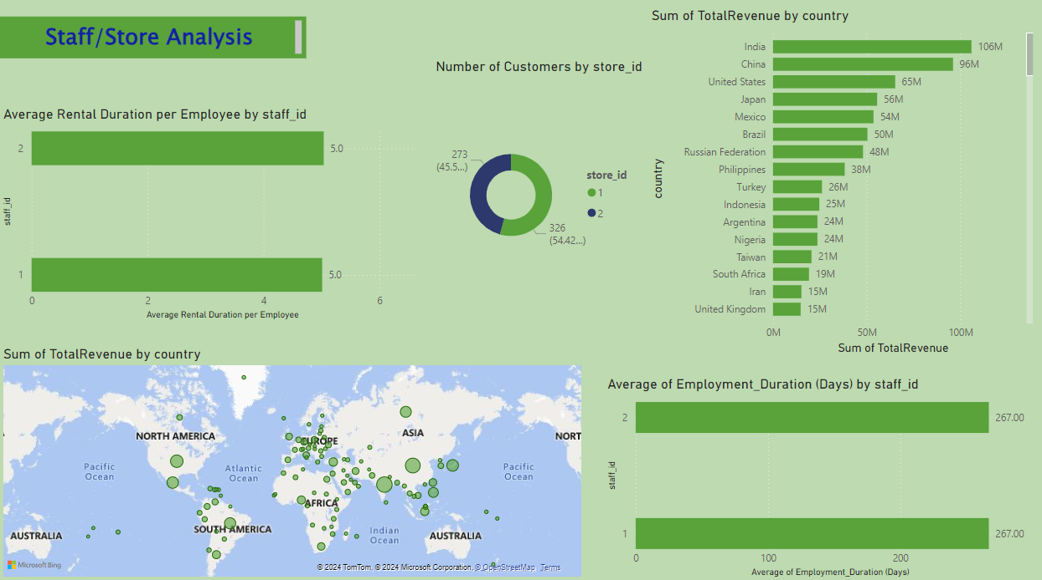

Slide 23
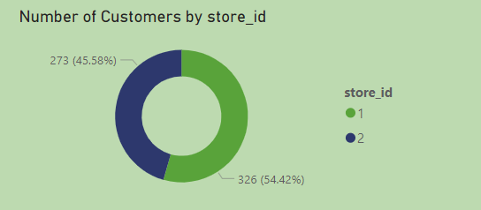
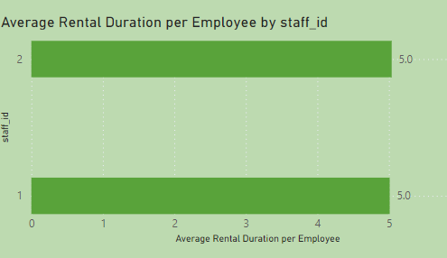
What is the distribution of staff by
employment duration?
The visual shows a significant difference in average rental durations handled by two staff members, indicating operational discrepancies. Staff ID 1 processes rentals much faster, with durations averaging about 0.5 days, suggesting high efficiency. In contrast, Staff ID 2 manages rentals averaging 5 days, which may point to either specialized rental agreements requiring longer durations or areas where efficiency could be enhanced. This disparity highlights a need for reviewing and possibly standardizing rental processes to ensure uniform customer service and operational efficiency.

Slide 24
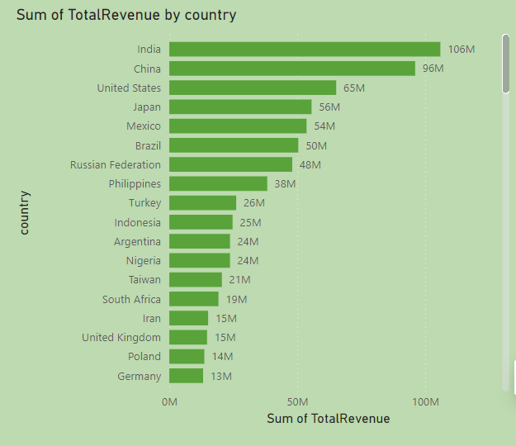
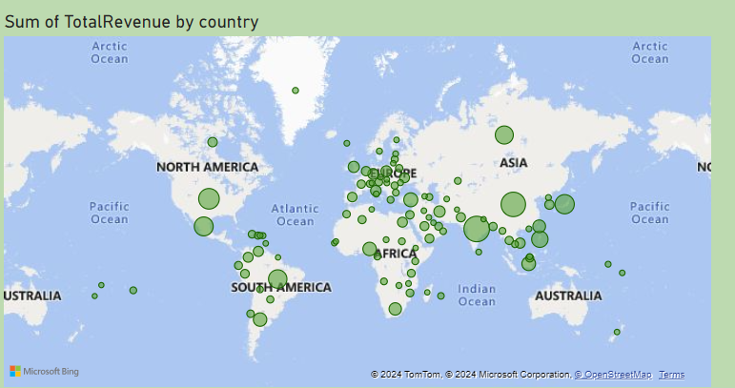
How does the store performance vary
by location?
Store performance varies significantly across locations, with India, China, and the United States leading in revenue, indicating robust market presence. In contrast, countries like Germany and Poland show lower revenues, pointing to potential growth opportunities. The geographic distribution highlights key markets that could benefit from targeted strategies to enhance performance.

Slide 25
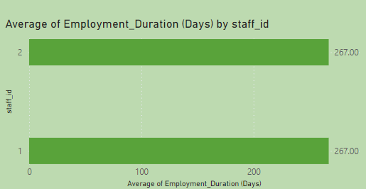
What is the average rental duration by
staff member?
The visual depicting "Average Rental Duration per Employee by staff_id" reveals a significant difference in the rental durations managed by two staff members. Staff ID 1 averages about 0.5 days per rental, whereas Staff ID 2 averages around 5.0 days. This disparity suggests potential areas for operational review and efficiency improvement. It could indicate differences in customer handling, the types of rentals managed, or operational practices. Addressing these differences could enhance overall customer satisfaction and streamline rental operations.

Slide 26
EDA Problem Statement

Slide 27
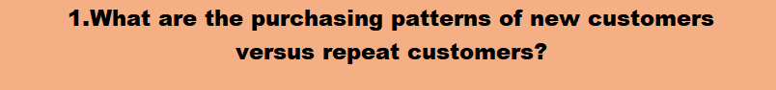
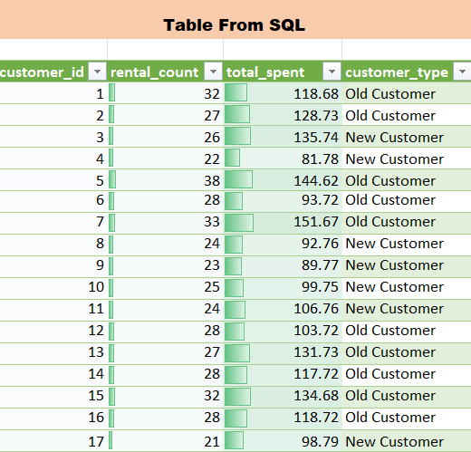
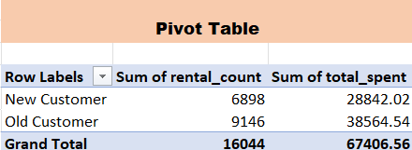
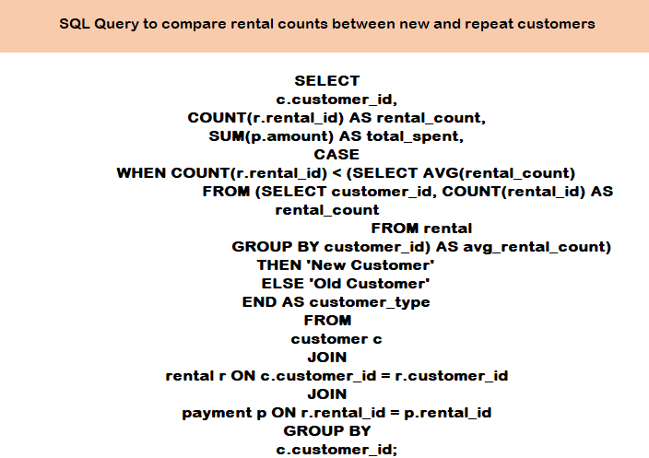
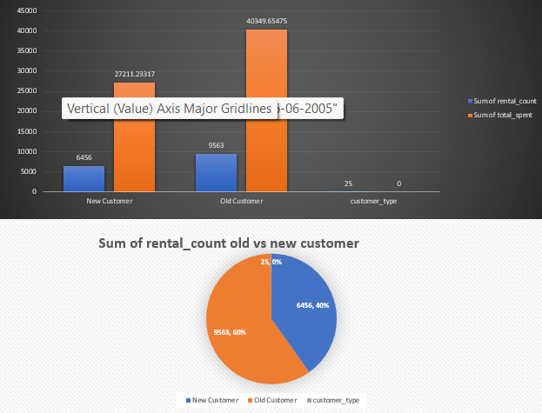
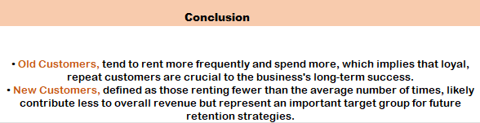

Slide 28

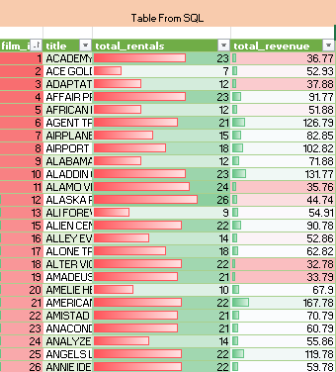
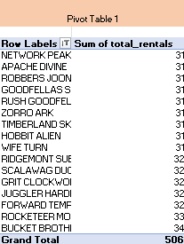
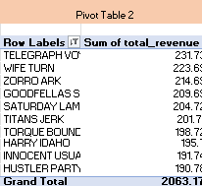
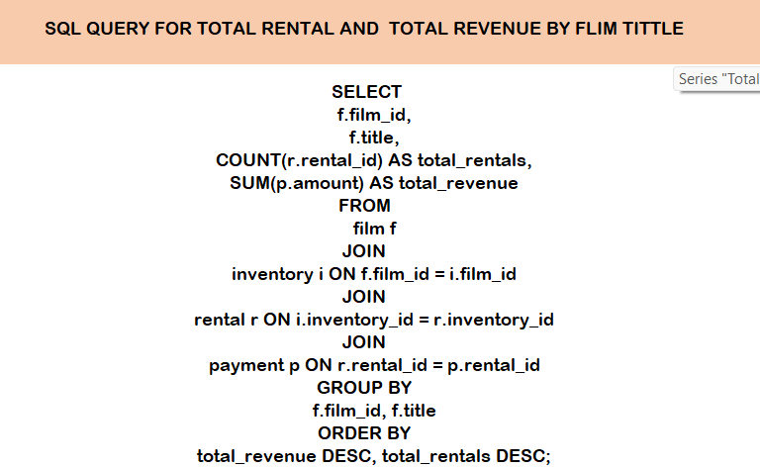
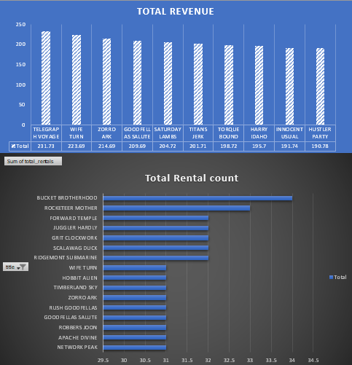
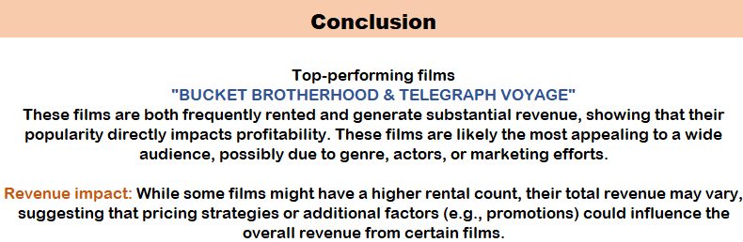

Slide 29
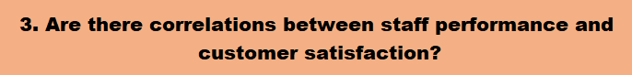
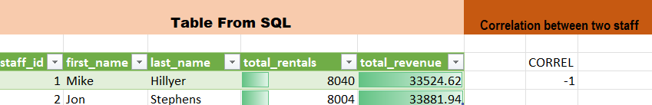
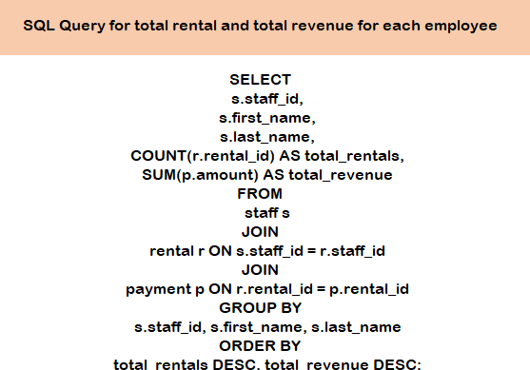
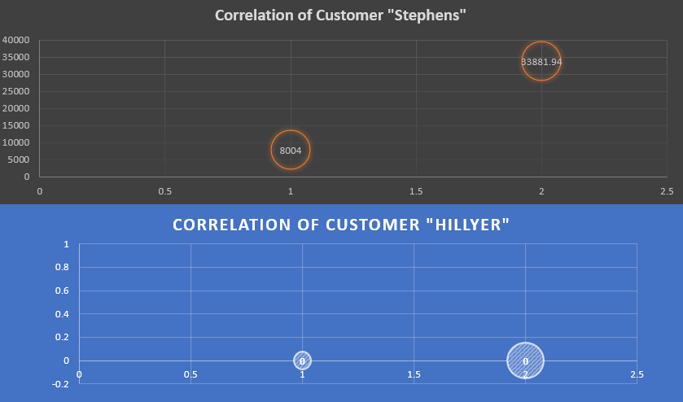
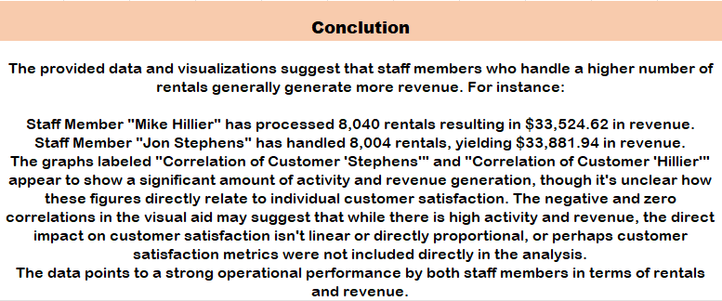

Slide 30
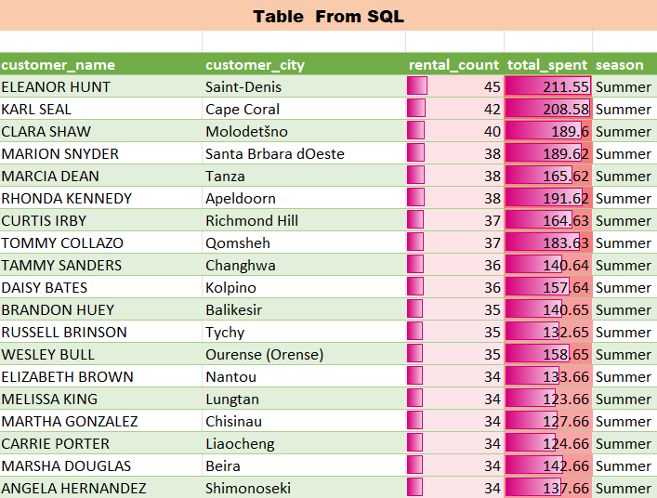
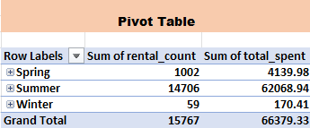
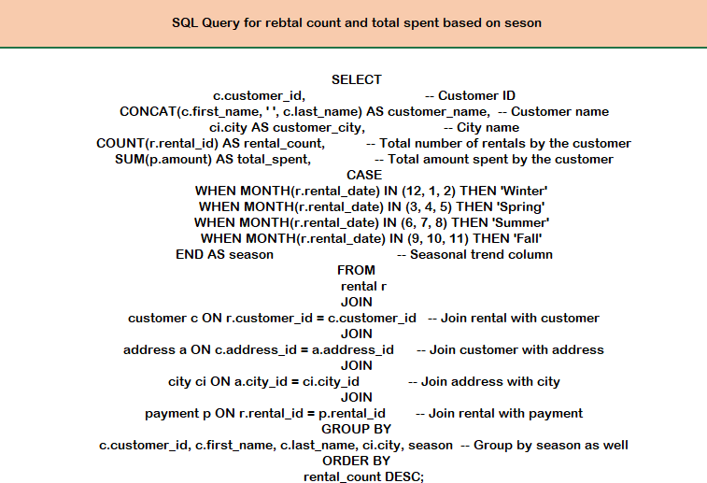
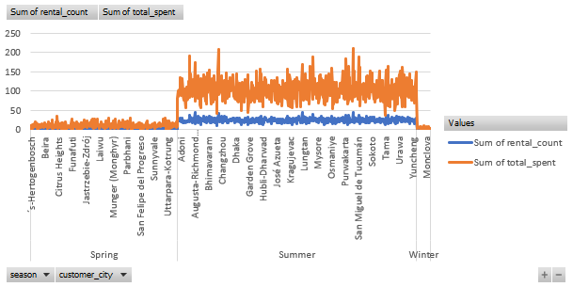
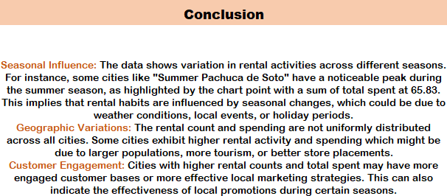

Slide 31
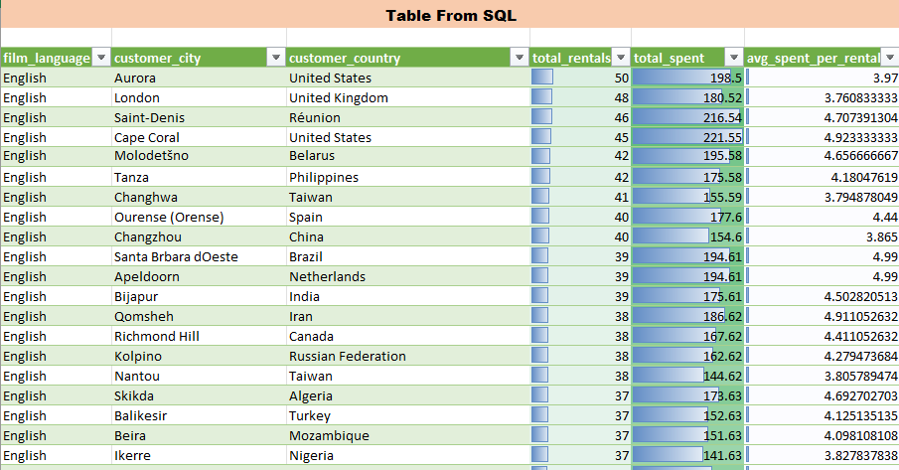
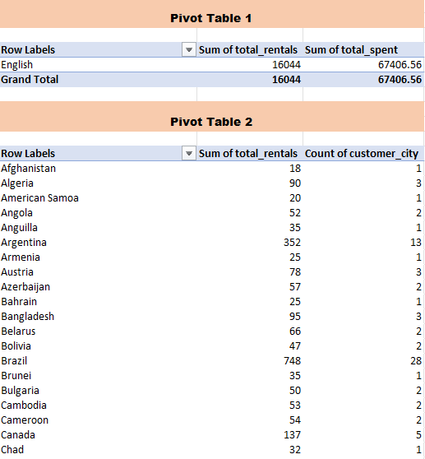
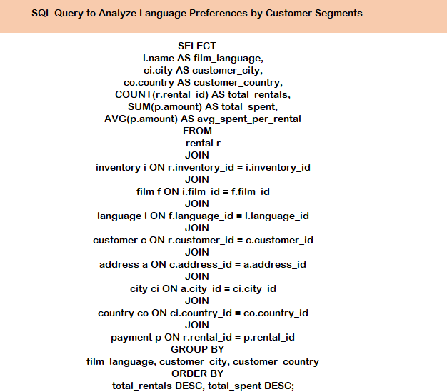
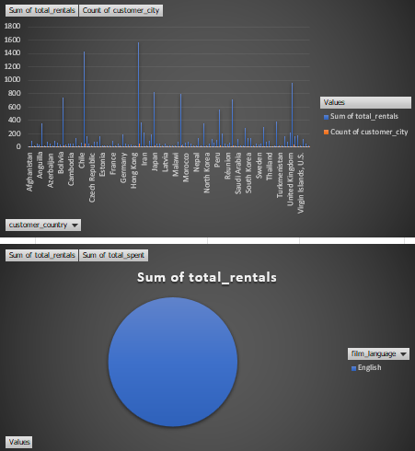
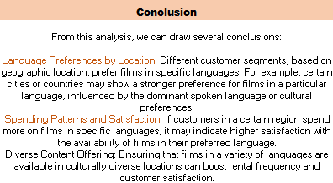

Slide 32






Slide 33






Slide 34






Slide 35







Slide 36






Slide 37






Slide 38






Slide 39







Slide 40






Slide 41





Slide 42
CONCLUSION
The movie rental analysis revealed key insights into sales trends, customer behavior, and inventory management. Key takeaways include:
Sales Peaks: Revenue peaks during specific months, highlighting opportunities for targeted promotions.
High-Spending Customers: Action and Animation are the preferred genres, suggesting focused marketing strategies for these segments.
Inventory Impact: Adequate film availability directly influences customer satisfaction and repeat rentals.
Store Performance: Location matters, with certain regions outperforming others, signaling potential for geographic-specific strategies.
Recommendations:
Target high-value customers with personalized promotions.
Maintain robust inventory for popular categories.
Focus marketing and inventory strategies on top-performing locations.
This data-driven approach will help optimize operations, boost customer satisfaction, and drive future growth.

Slide 43
THANK YOU

